Slide 1


ONLINE CERTIFICATION COURSES
WEB PORTAL
Mentored by:Dr.T.Mala(Director,CDOE)

Slide 2

Intern Students
Manish M - 2022115080
Vishal Sanjeevi A.S - 2022115127
Vignesh S - 2022115093
Yogasimman R - 2022115125
Kesav Kumar J - 2022115088
Gopalakrishnan K - 2022115075

Slide 3

Introduction
The Center for Distance and Online Education(CDOE) at Anna University provides flexible, high-quality education, offering certification programs to enhance academic and professional skills for career growth.
A team of six interns worked together to develop an online certification platform offering courses from academic centers and leading organizations.
The platform allows students to enroll, access materials, interact with instructors, and earn official certifications, showcasing skills in web development and system integration.

Slide 4

Overview
Our platform offers online certification courses accessible worldwide, aimed at providing high-quality education to students and professionals across the globe.
In collaboration with 8 leading companies, we offer 87 courses across various domains, split across 13 centers of Anna University. These courses are available in three learning formats: MOOC, synchronous learning, and self-paced learning.
Payments for the courses are processed on our website, which then redirects students to the partner companies’ LMS platforms for course delivery. Upon successful completion, students are awarded certification from Anna University.

Slide 5

User Roles and Access Management
01.
02.
03.
Student
Admin & Coordinator
Vendor
Browse and purchase curated courses for skill development, personal growth, teaching enhancement, and career advancement with certifications and specialization.
Admin: Oversee platform operations, manage users, and generate reports.
Coordinator (Anna University): Coordinate courses, monitor progress, and ensure academic alignment.
Access performance insights, track course engagement, and analyze user feedback.

Slide 6

Technology Stack
HTML, CSS, JavaScript
PHP
PostgreSQL
AWS Cloud
PayU Biz

Slide 7
User Journey and Web Portal Architecture

Slide 8
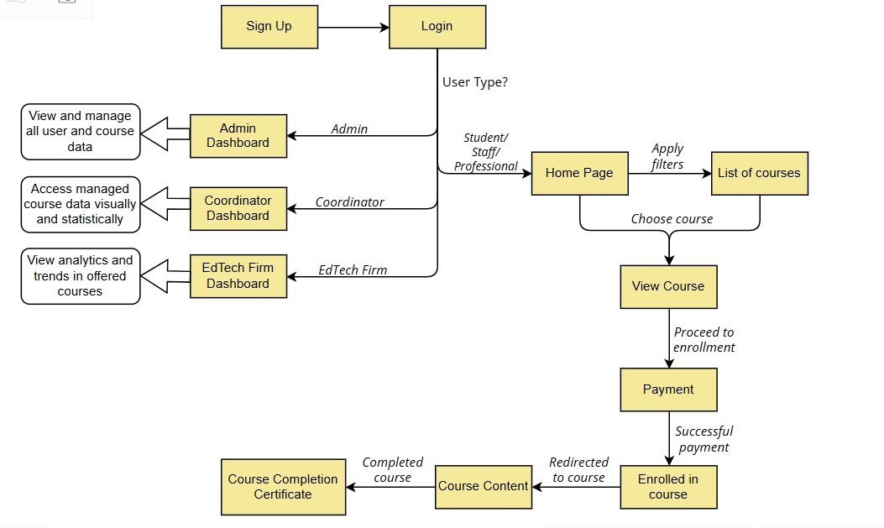

Slide 9
Partnership with Leading EdTech Companies
As part of this project, we established strong partnerships with 8 leading tech companies to provide a wide range of online certification courses for students. These collaborations have been pivotal in creating a rich and diverse course catalog, aimed at equipping learners with in-demand skills that align with industry needs.
Each of our partners has contributed high-quality, industry-specific courses, enabling learners to access a variety of programs tailored to their career goals and professional development.
Our partners provided experienced instructors who developed the curriculum and guided students through their learning journey.

Slide 10
API Connection
“GO TO COURSE” BUTTON
RETRIEVE PASSPHRASE AND URL
GENERATE SALT & ENCRYPTION KEY
BASE64 ENCODE DATA
ENCRYPT DATA(AES)
GENERATE INITIALIZATION VECTOR (IV)
PREPARE ENCRYPTED DATA
SEND ENCRYPTED TOKEN AND REDIRECT URL
REDIRECT TO COMPANY URL

Slide 11
Data Backup and Recovery Flow

Slide 12
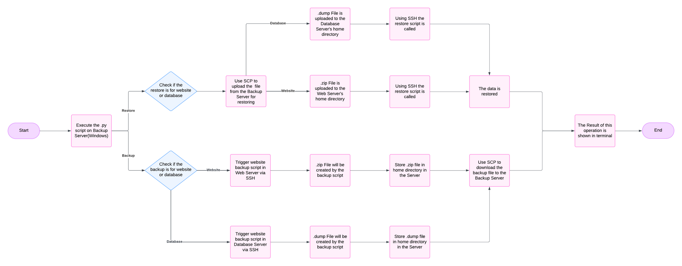

Slide 13

Conclusion
The cloud-based online certification platform developed in collaboration with Anna University provides secure, scalable, and accessible learning for users worldwide. Through partnerships with leading companies, the platform offers a wide variety of courses, ensuring high-quality education. With a seamless user experience, students can easily enroll, learn, and earn certifications, empowering them with valuable skills for their professional growth.

